Slide 1


Seminar #4
Topic 1
the step-up converter
Reporter：DingYibo NieYongxin WuDi
Group 7
Nov.23 2020

Slide 2
Work Division
Ding Yibo:
Powerpoint , Simulation, Discussion
Wu Di:
Simuation, Discussion
Nie Yongxin
Simulation , Powerpoint , Discussion

Slide 3


01
Simulation model
02
Task 1
calculate the theoretical value of Δu_{L}, Δi_{L}
03
Task 2
the relationships between D and G, Δu_{L}, Δi_{L}

Slide 4
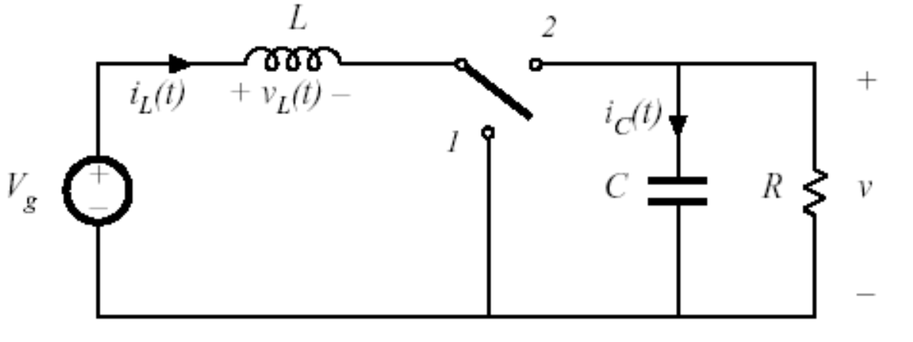
Circuit diagram
Fig. 1 Boost converter
1

Slide 5
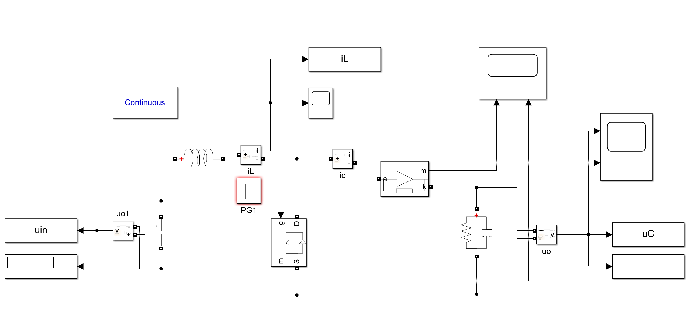
Simulink circuit diagram
Fig. 1-1 Simulation model
Tab. 1-1 Parameter setup of our group
Boost converter | Vin | Vo | RL | fs | L | C
 | 300V | 400V | 100Ω | 100kHz | 800uH | 200uF
2

Slide 6

Task 1

Slide 7
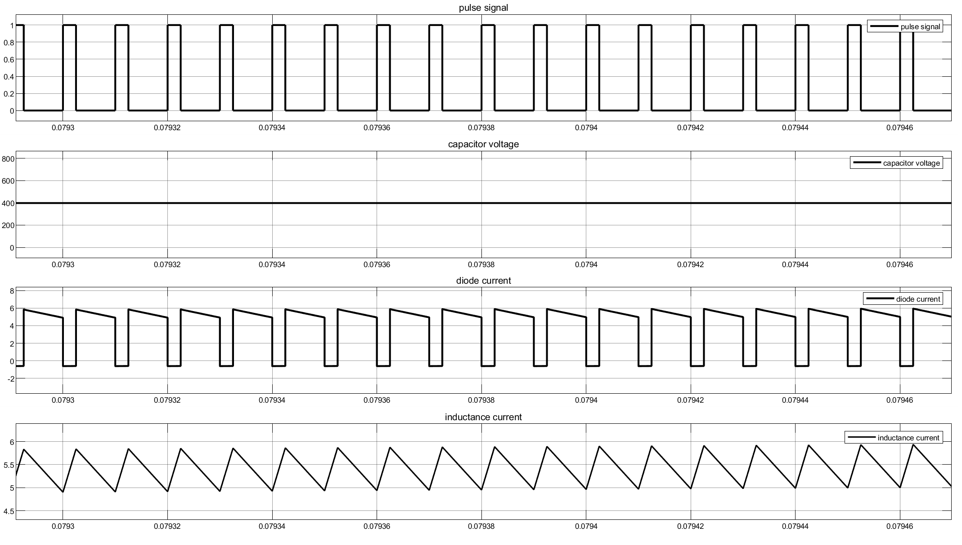
Waveform of Simulation for checking
Fig. 1-2 Waveform of Simulation for checking
When the duty cycle is 25%, the output voltage is 400V.
3

Slide 8
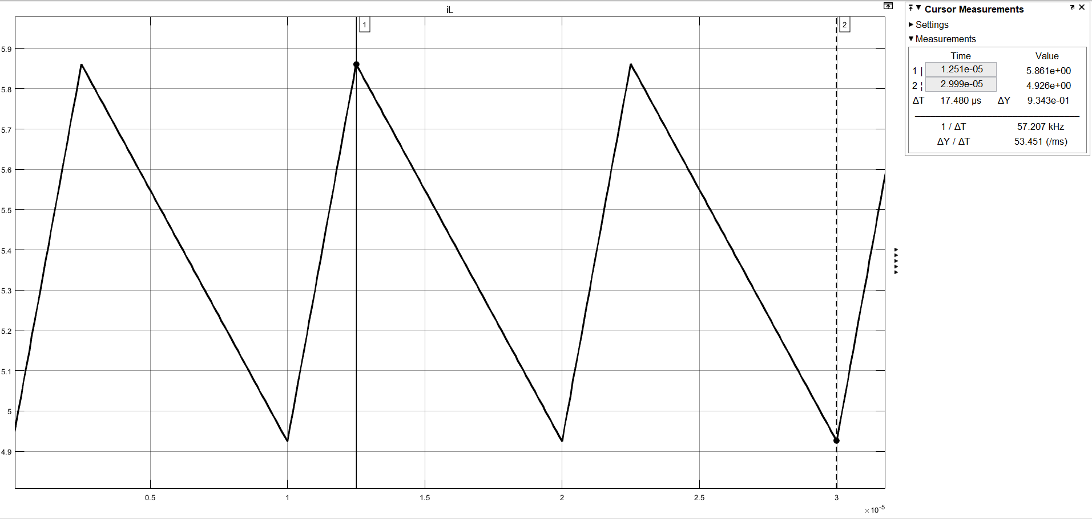
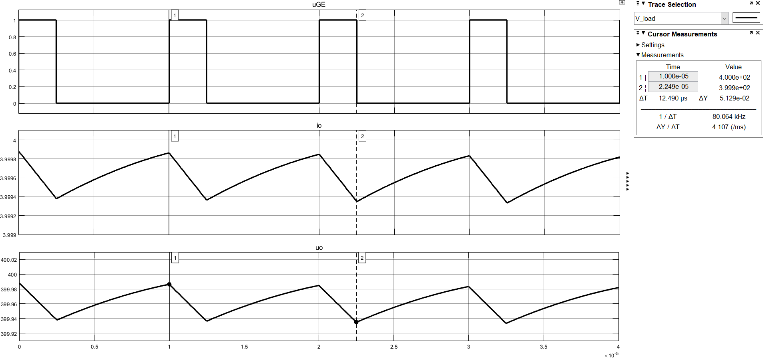
Result waveform
Fig. 1-3 Inductor current ripple
Fig. 1-4 Capacitor voltage ripple
4

Slide 9
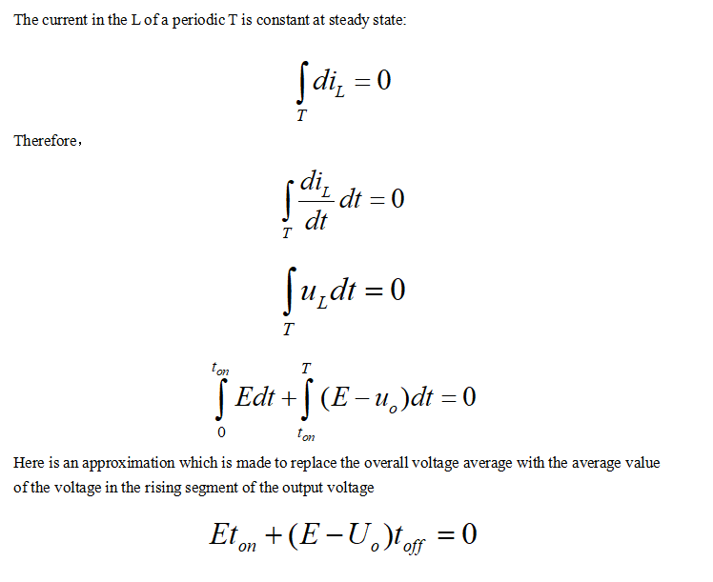
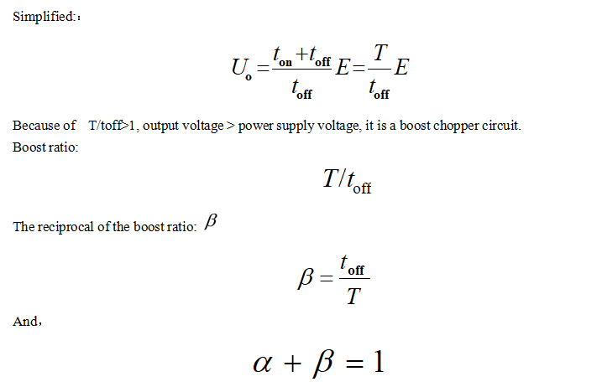
Theoretical Analysis
5

Slide 10
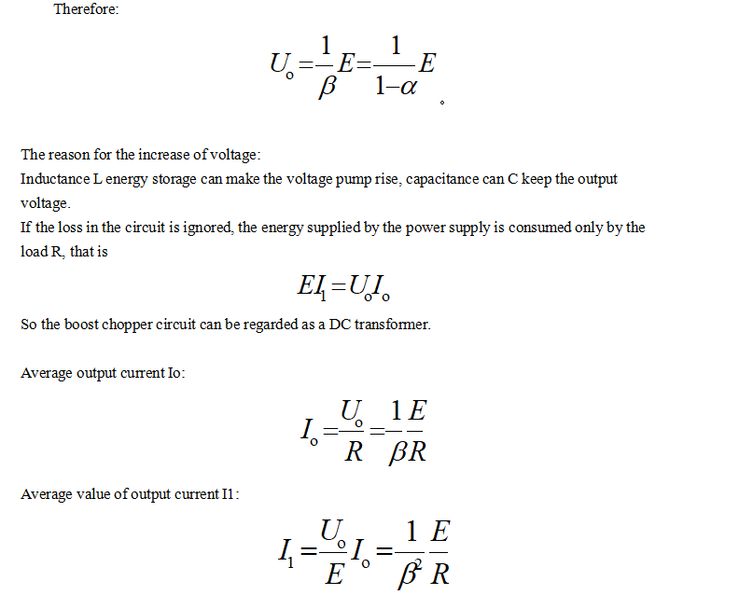
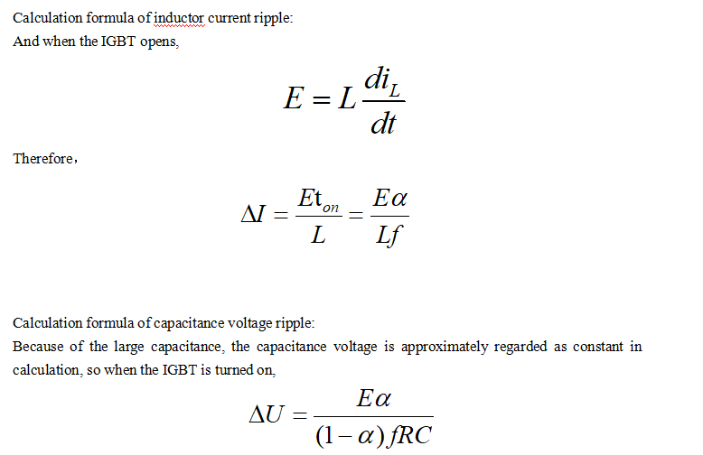
Theoretical Analysis
6

Slide 11
Comparison between theory and simulation
Theoretical formula:
Tab. 1-2 Comparison of theoretical and simulation value
 | Theoretical value | Simulation value | Percentage error
Inductor current ripple | 0.9375A | 0.9343A | 0.34%
Capacitor voltage ripple | 0.05V | 0.0513V | 2.58%
7

Slide 12
Task 2

Slide 13
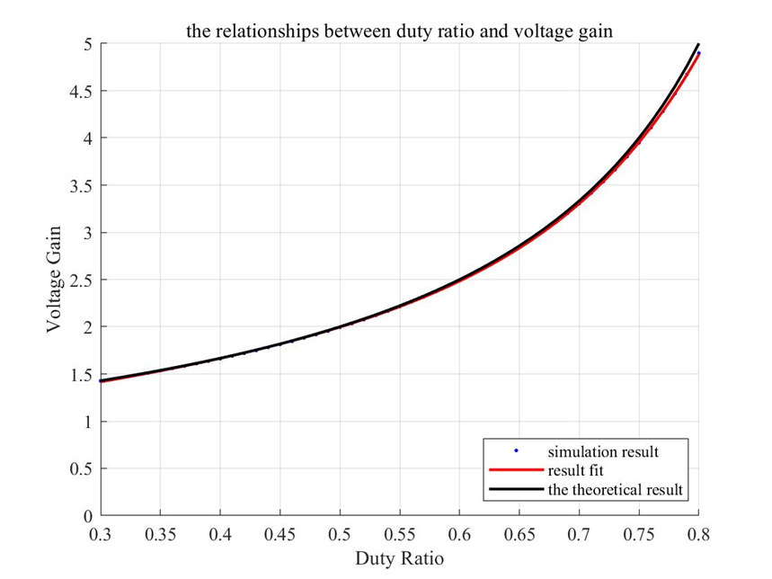
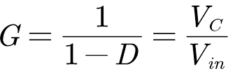
Relationship between duty ratio and voltage gain
Fit Result
gof =
sse: 0.0010
rsquare: 1.0000
dfe: 47
adjrsquare: 1.0000
rmse: 0.0046
8
Fig. 1-5 Relationship between G and D

Slide 14
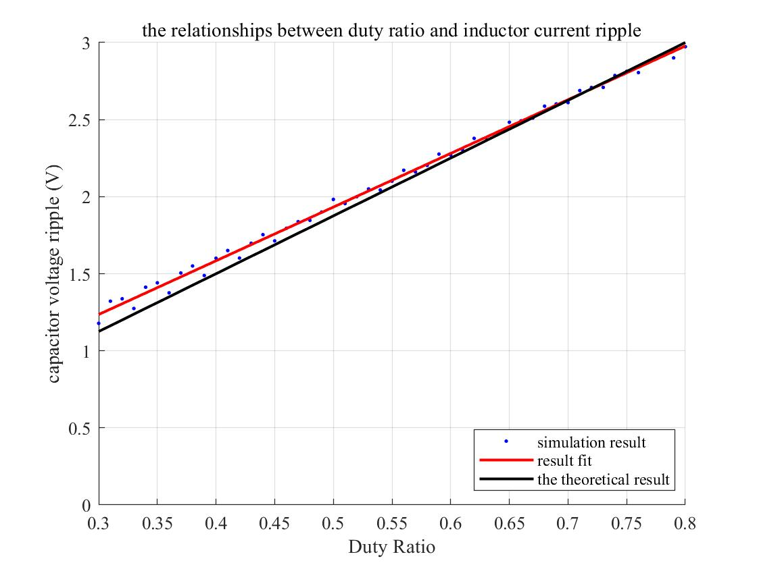
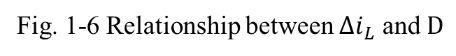
Relationship between duty ratio
and inductor current ripple
Fit Result
gof =
sse: 0.0452
rsquare: 0.9966
dfe: 49
adjrsquare: 0.9966
rmse: 0.0304
9
Fig. 1-6 Relationship between ${∆i}_{L}$ and $D$

Slide 15
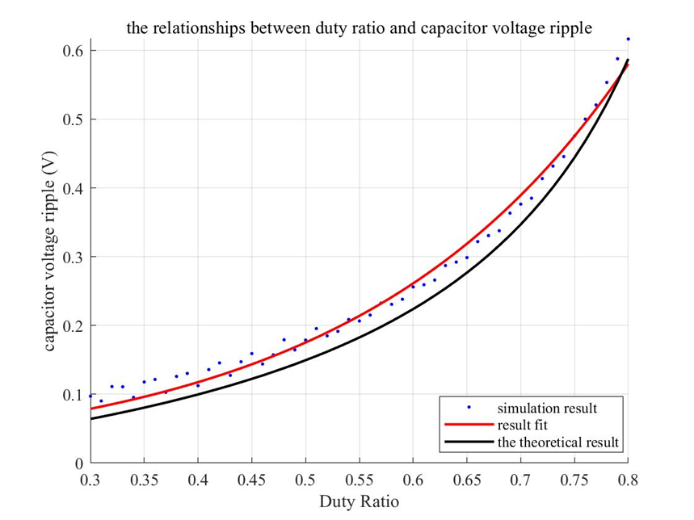
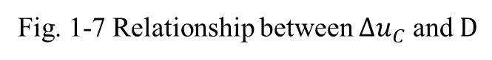
Relationship between duty ratio
and capacitor voltage ripple
Fit Result
gof =
sse: 0.0104
rsquare: 0.9898
dfe: 49
adjrsquare: 0.9896
rmse: 0.0146
10
Fig. 1-7 Relationship between $∆u_{C}$ and $D$

Slide 16
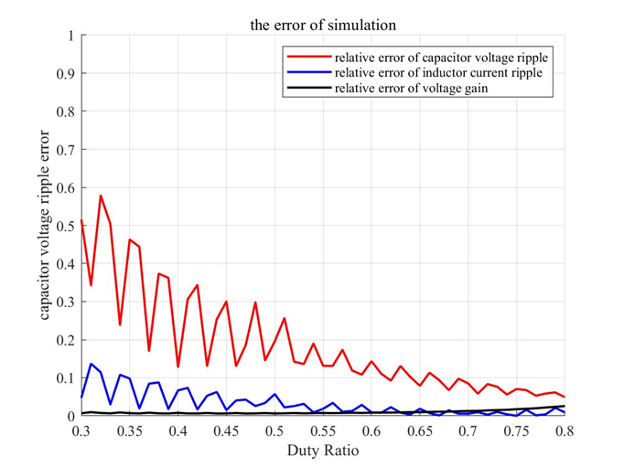
Simulation Relative Error
11

Slide 17
Thanks for listening.
Your question and your comments
are welcome

Slide 18
Seminar4 Topic2
Full-bridge rectifier & Full-wave inverter
Reporter：DingYibo NIEYongxin WUDi
Group7
Nov.23 2020

Slide 19
Work Division
Ding Yibo:
Powerpoint , Simulation, Discussion
Wu Di:
Simuation, Discussion
Yuan Shuangyue:
Simulation , Discussion
1

Slide 20
Simulation Model
& Parameter Setup
01
Task 1
Operating principle & sequence
02
Task 2
Analysis about CCM & DCM
03
Task 3
Relationships between D and G
04
2

Slide 21
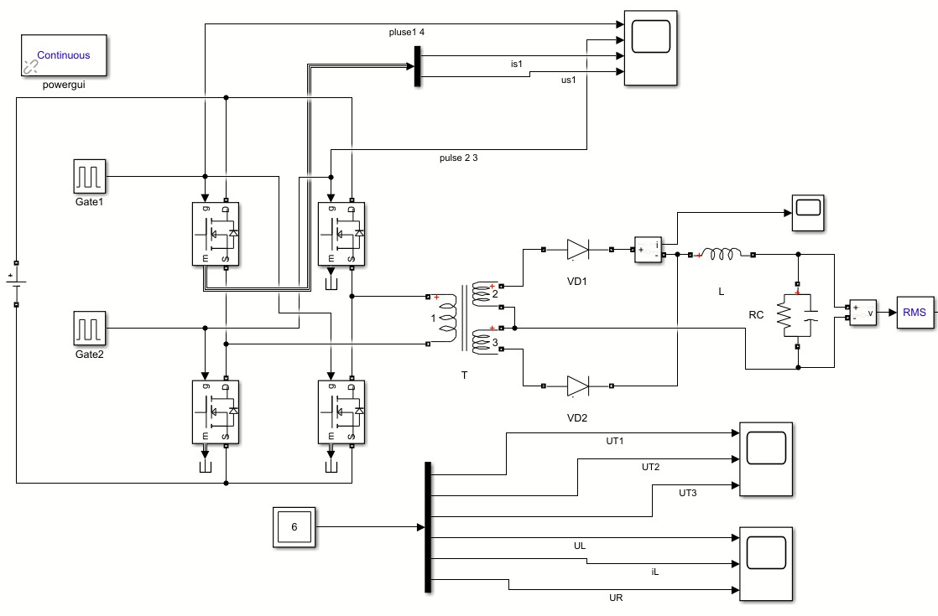
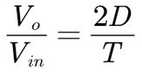
Part1 Simulation Model & Parameter Setup
Table 1. The Given Parameters for Topic2
R_{L} | f_{s} | L | C
10Ω | 100kHz | 300uH | 200uF
V_{in} | V_{o} | T
600V | 48V | 4:1:1
Therefore, Duty Ratio: D=0.16
Fig.1 Simulink model for topic2
3

Slide 22
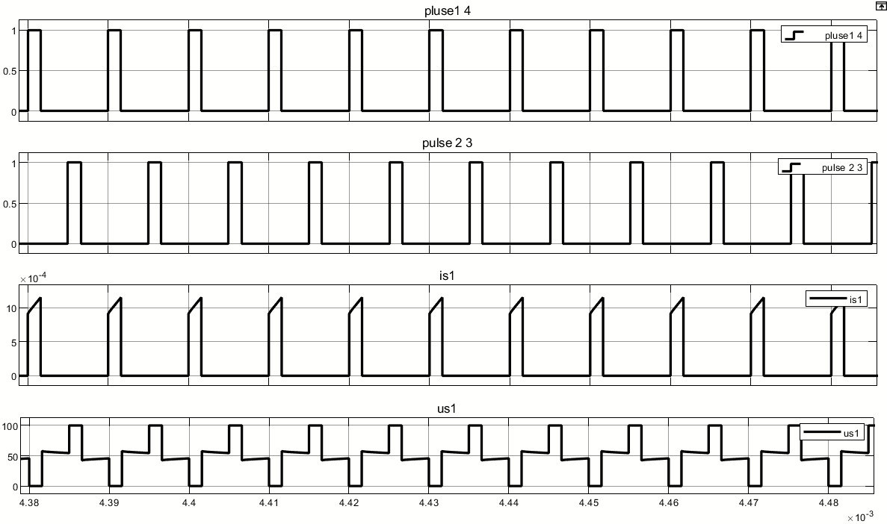
Part2: Task 1
Operating principle & sequence
(1) Full-bridge inverter
Time interval | Conducting MOSFETs
0-DT | S1, S4
DT-T/2 | \
T/2-(D+1/2) T | S2, S3
(D+1/2) T-T | \
D=0.16
Two groups of MOSFETs conducts complementarily
Fig.2 Waveforms of pulse signal and MOSFET
4

Slide 23
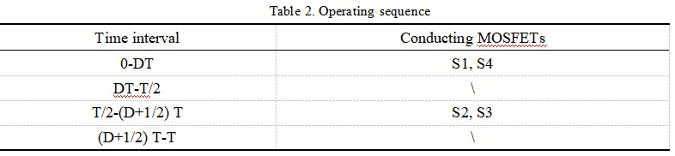
Part2: Task 1
Operating principle & sequence
Therefore, we could have the operating sequence:
5

Slide 24
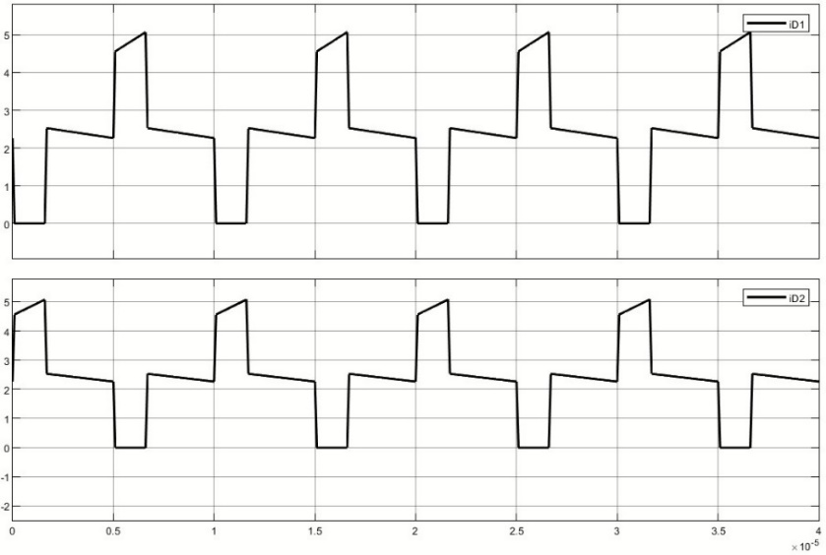
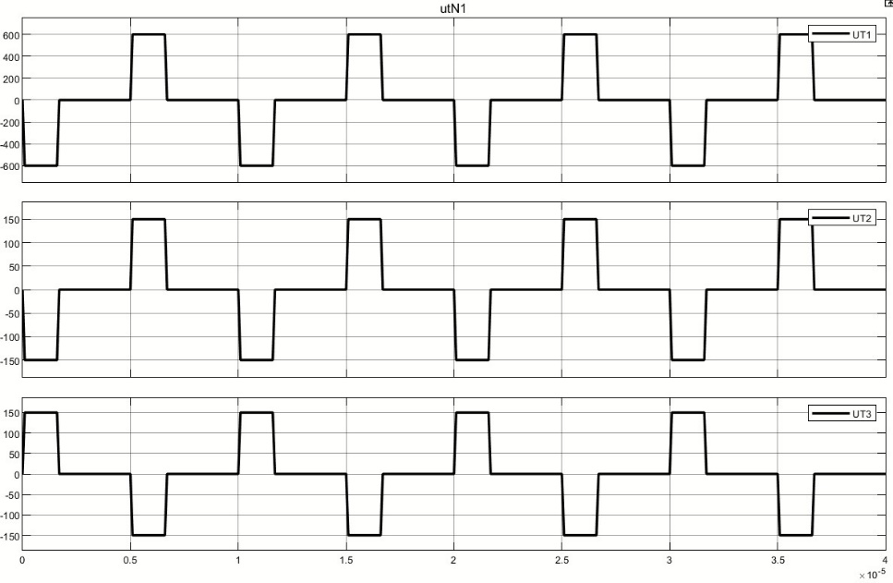
Part2: Task 1
Operating principle & sequence
(2) Full-wave rectifier
Fig. 4 Current waveform of diodes
Fig. 3 Voltage waveforms of transformer
4:1:1
6

Slide 25
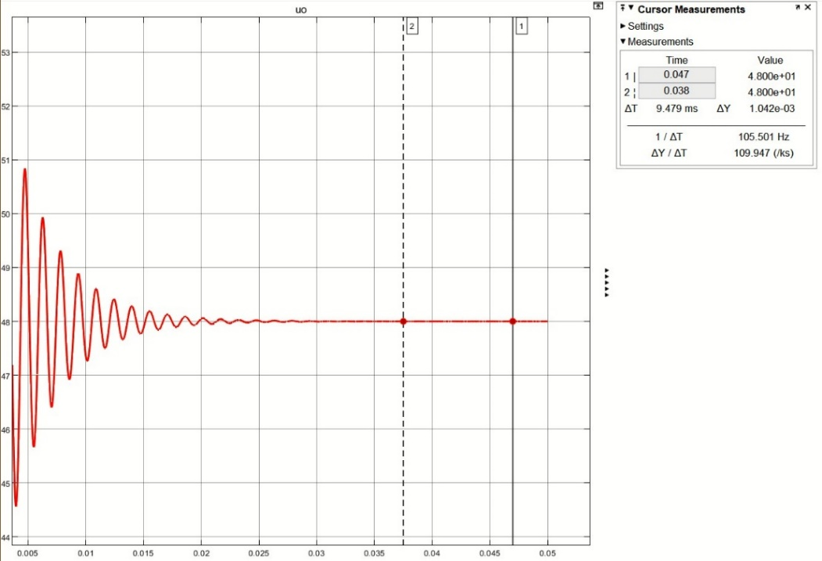
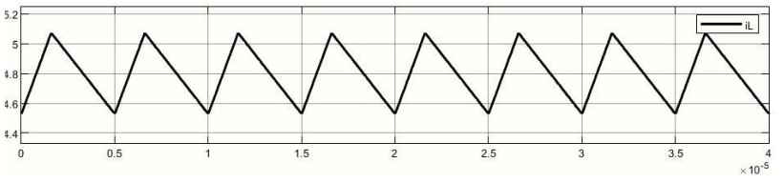
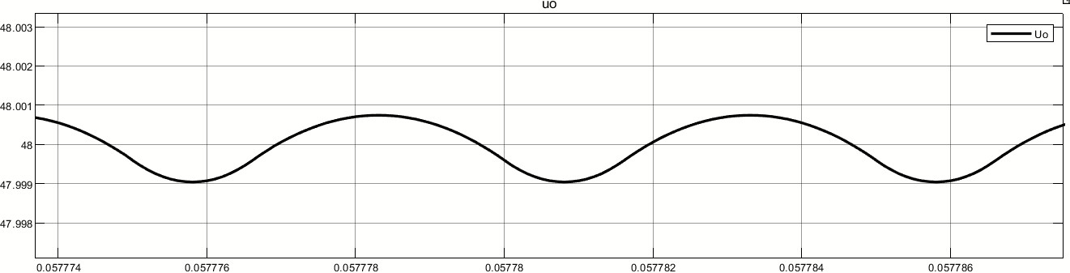
Part2: Task 1
Operating principle & sequence
Fig. 6 Waveform of inductor current
Fig. 5 Waveform of output voltage
Fig. 7 Detailed waveform of output voltage
7

Slide 26
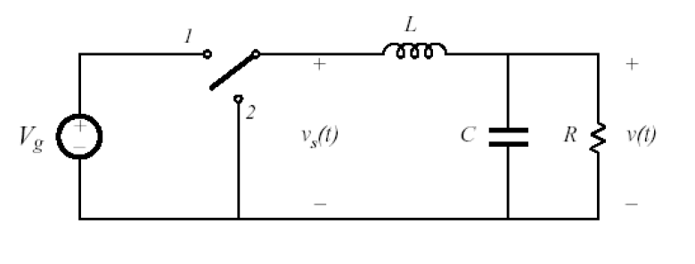
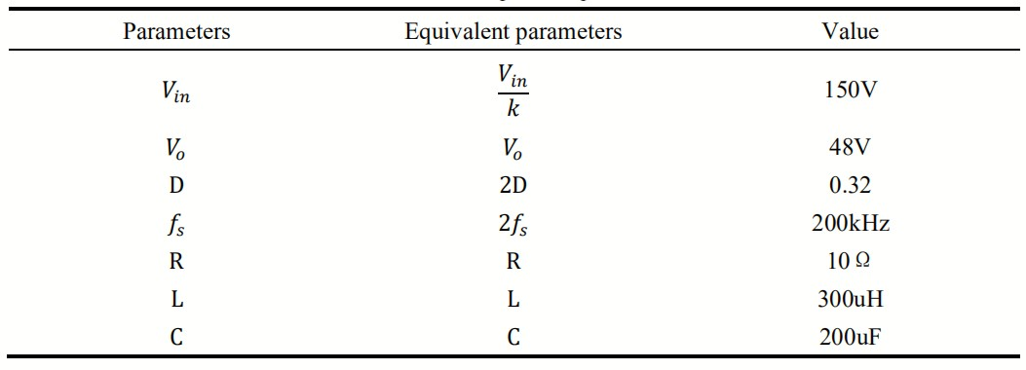
Part3: Task 2
Analysis about CCM & DCM
(1)Calculation of critical resistance
Tab.3 Equivalent parameters
Fig. 8 Equivalent buck converter
First, we could have the equivalent buck converter.
8

Slide 27
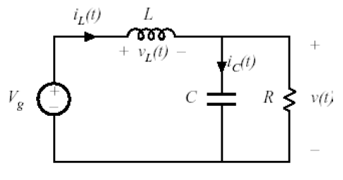
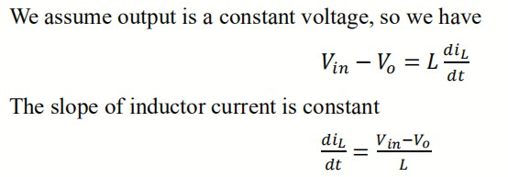
Part3: Task 2
Analysis about CCM & DCM
(1)Calculation of critical resistance
Fig. 9 On-state buck converter
Next, we analyze the on-state.
9

Slide 28
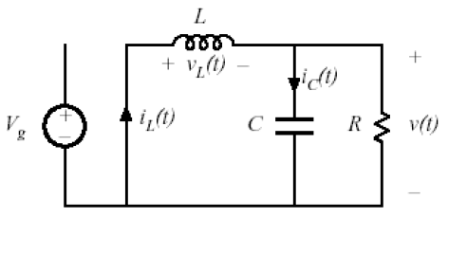
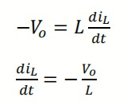
Part3: Task 2
Analysis about CCM & DCM
(1)Calculation of critical resistance
Similarly, we have
Fig. 10 Off-stste buck converter
Afterwards, we analyze the off-state.
10

Slide 29
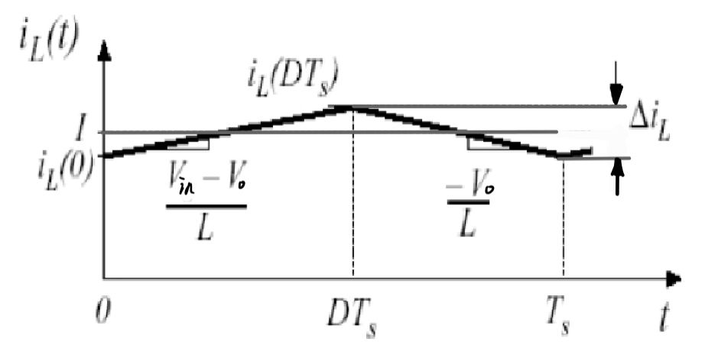
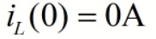
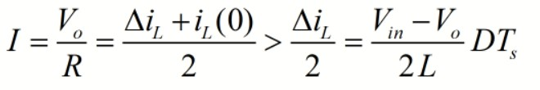
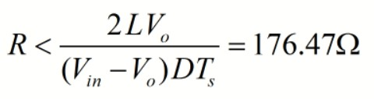
Part3: Task 2
Analysis about CCM & DCM
(1)Calculation of critical resistance
When the resistor is at its critical value
To make the current continuous, we have
Therefore, we have
Fig. 11 Waveform of inductor current
11

Slide 30
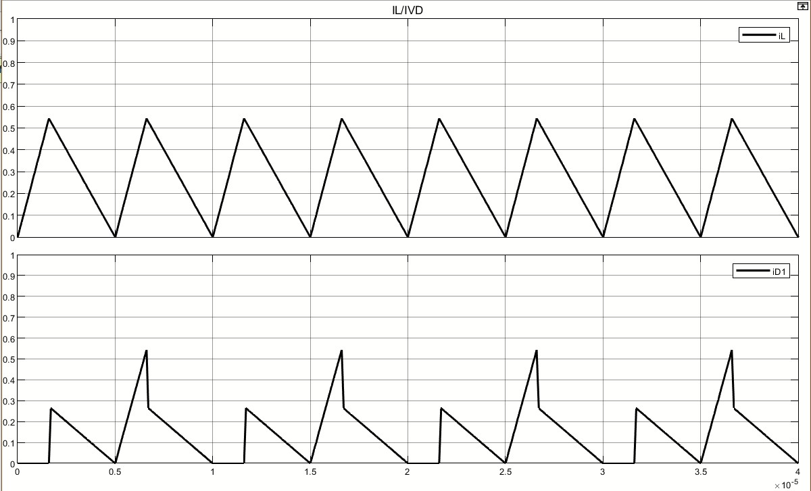
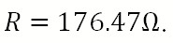
Part3: Task 2
Analysis about CCM & DCM
(2)Waveforms under different resistance
Fig. 11 Critical mode current
12

Slide 31
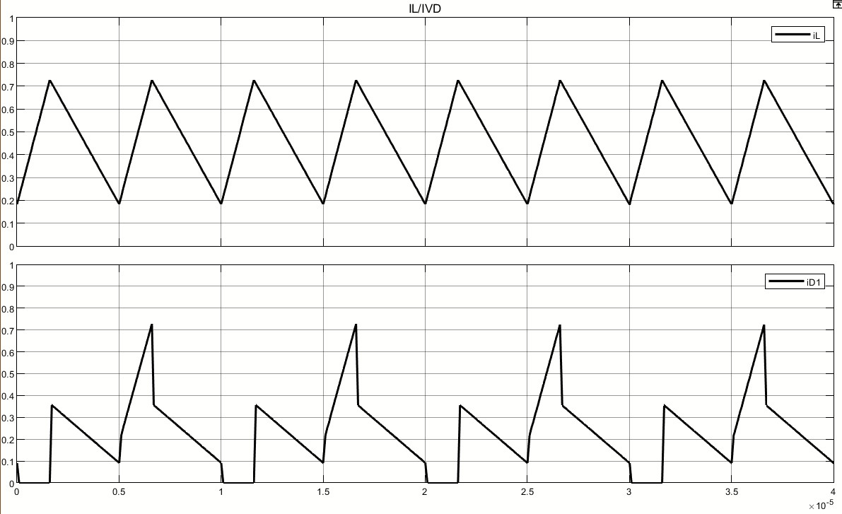
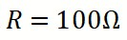
Part3: Task 2
Analysis about CCM & DCM
(2)Waveforms under different resistance
Fig. 12 CCM mode current
13

Slide 32
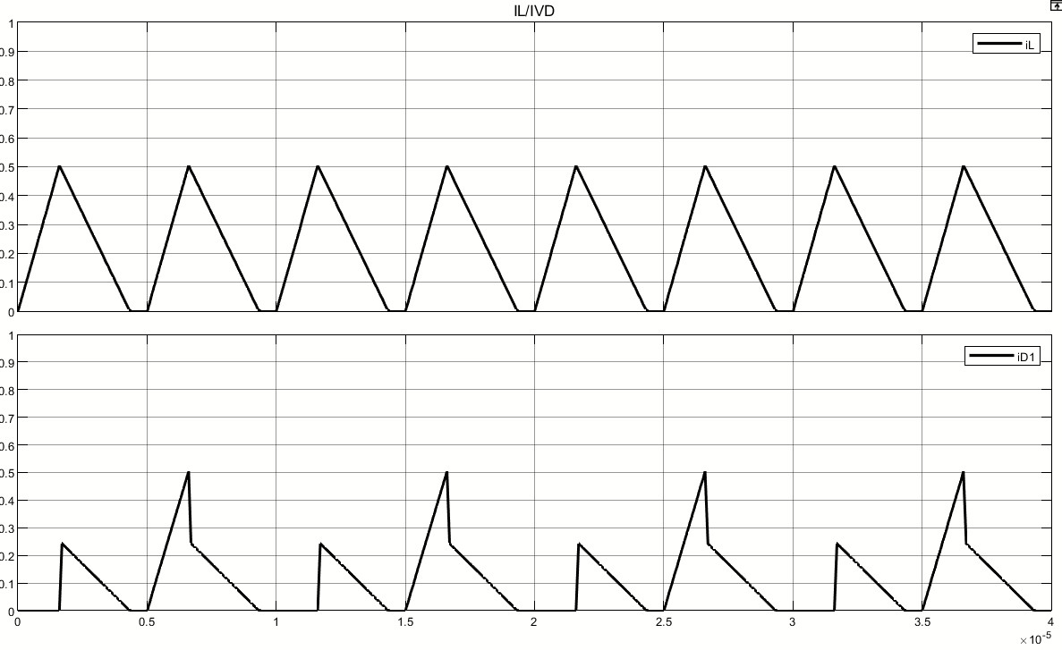
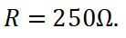
Part3: Task 2
Analysis about CCM & DCM
(2)Waveforms under different resistance
Fig. 13 DCM mode current
14

Slide 33
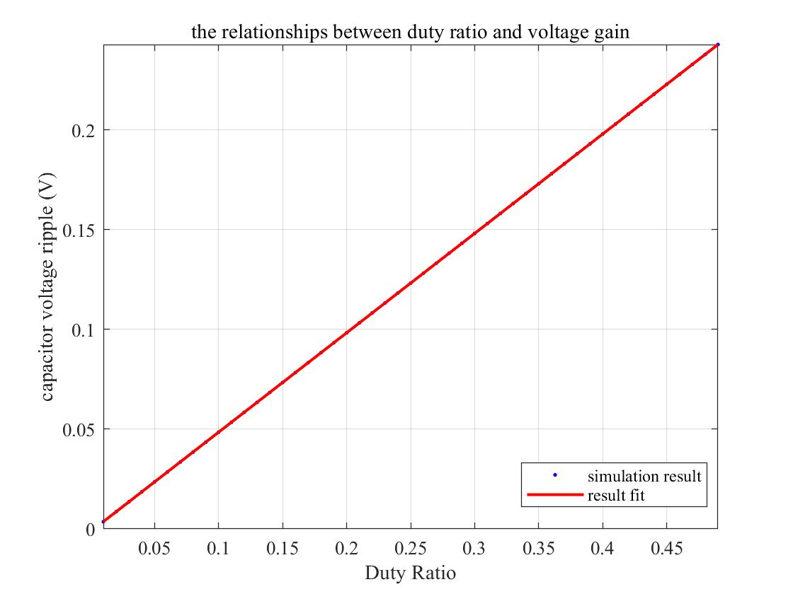
Part4: Task 3
Relationships between D and G
Based on the defintition of voltage gain, we have
The slope of the curve should be 0.5
Fig. 14 DCM mode current
15

Slide 34
Thanks for listening.
Your question and your comments
are welcome

